Slide 1

Customer Shopping Behavior Analysis
Uncovering insights from 3,900 purchases to guide strategic business decisions

Slide 2

Dataset at a Glance
3,900
18
50
Total Purchases
Data Points
Locations
Transactions analyzed across all categories
Features tracked per customer
Geographic coverage
25
Products
Items purchased

Slide 3
Data Preparation Journey
01
02
03
Data Loading & Exploration
Missing Data Handling
Feature Engineering
Imported dataset using pandas, checked structure with df.info()
Imputed 37 missing Review Ratings using category medians
Created age_group and purchase_frequency_days columns
04
05
Data Consistency
Database Integration
Dropped redundant promo_code_used column
Loaded cleaned data into PostgreSQL for analysis

Slide 4

Revenue Insights
Gender Revenue Split
Age Group Performance
Male customers: $157,890
Young Adult: $62,143
Female customers: $75,191
Middle-aged: $59,197
Adult: $55,978
Male shoppers generate 2x more revenue
Senior: $55,763

Slide 5

Top-Rated Products
Gloves
Sandals
Boots
3.86 rating
3.84 rating
3.82 rating
Hat
Skirt
3.80 rating
3.78 rating
Average review rating across all products: 3.75

Slide 6



Shipping & Spending Patterns
$60.48
$58.46
Express Shipping
Standard Shipping
Average purchase amount
Average purchase amount
High-Value Discount Users
839 customers used discounts but still spent above average
Smart shoppers maximizing value without sacrificing quality

Slide 7
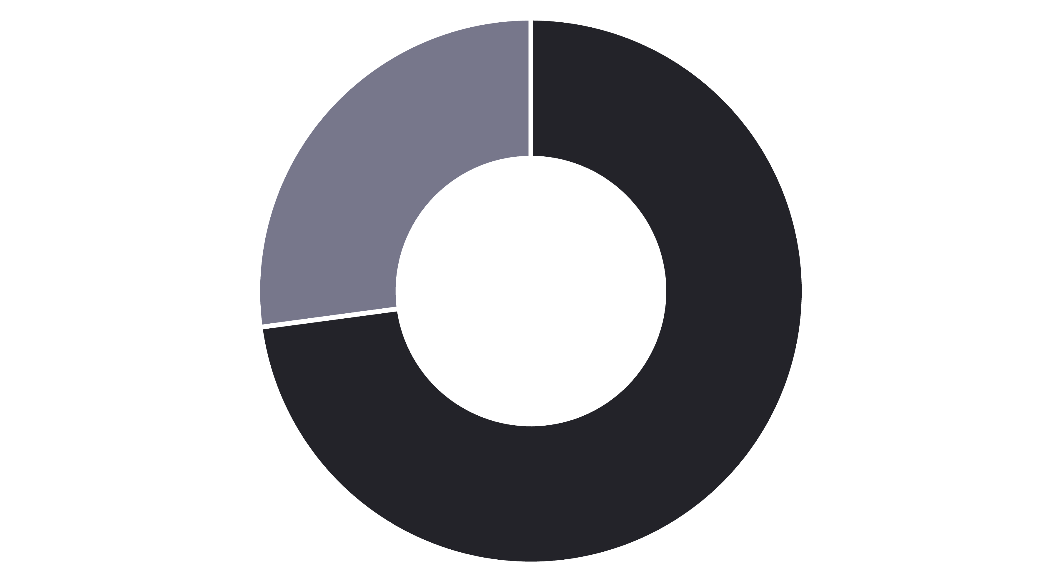
Subscription Status Analysis
Non-Subscribers
Subscribers
Subscribers
Non-Subscribers
Key Insight
1,053 customers
2,847 customers
Similar spending patterns, but massive untapped subscription potential
$59.49 avg spend
$59.87 avg spend
$62,645 total revenue
$170,436 total revenue

Slide 8


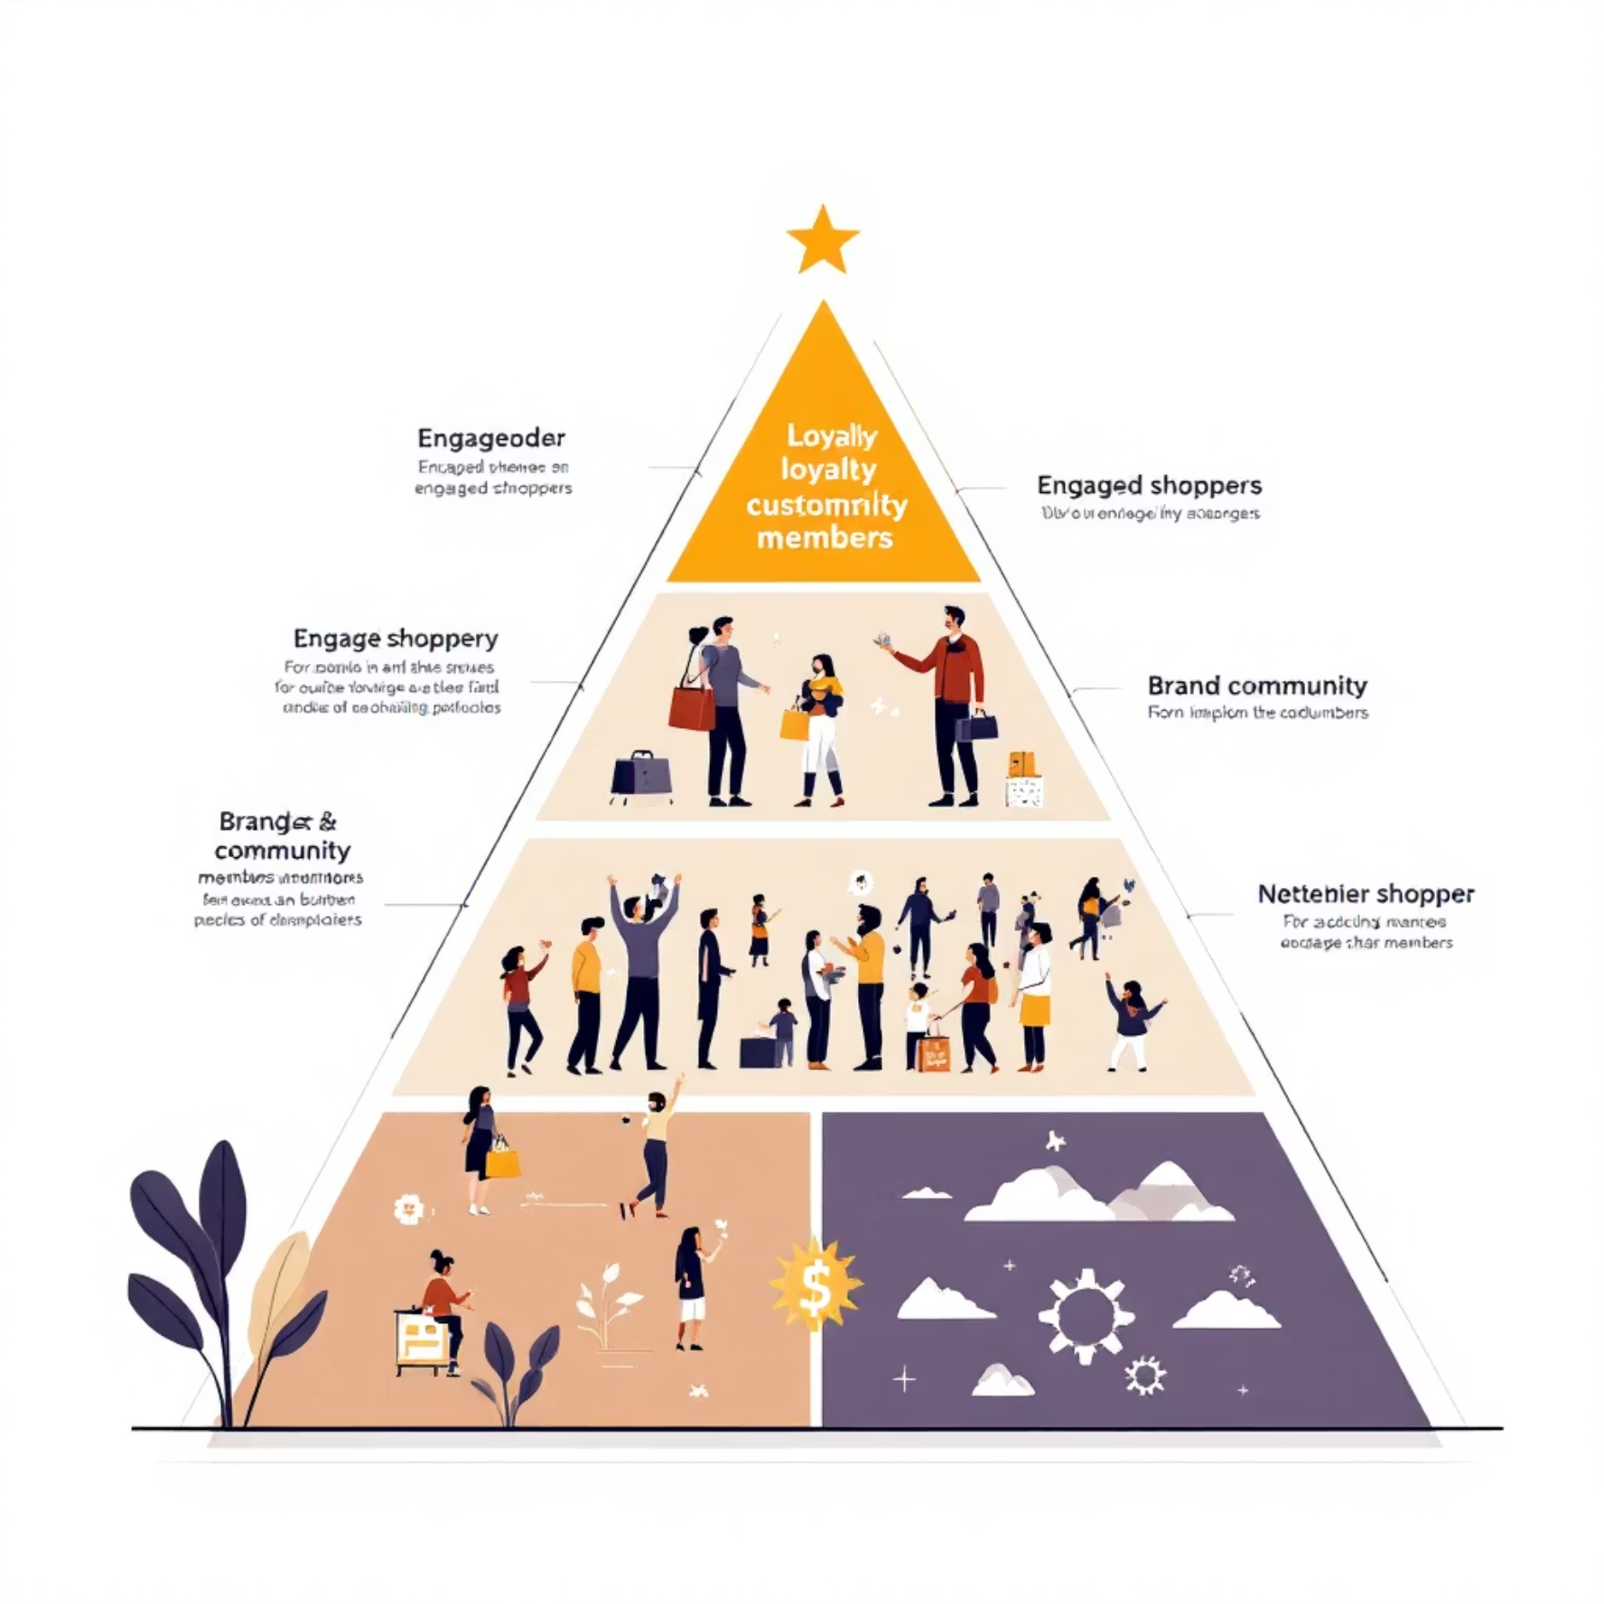
Customer Segmentation
New
1
83 customers
2
Returning
701 customers
3
Loyal
3,116 customers
Repeat Buyer Behavior
Customers with 5+ purchases:
958 are subscribers
2,518 are not subscribers

Slide 9

Category Performance
Clothing
Accessories
Footwear
Outerwear
Top sellers: Blouse, Pants, Shirt
Top sellers: Jewelry, Sunglasses, Belt
Top sellers: Sandals, Shoes, Sneakers
Top sellers: Jacket, Coat
Discount-dependent products: Hat (50%), Sneakers (49.66%), Coat (49.07%), Sweater (48.17%), Pants (47.37%)

Slide 10
Strategic Recommendations
Boost Subscriptions
Customer Loyalty Programs
Review Discount Policy
73% of customers aren't subscribed. Promote exclusive benefits to convert high-value shoppers.
Balance sales boosts with margin control—some products heavily discount-dependent.
Reward repeat buyers to accelerate movement into "Loyal" segment (80% of customer base).
Product Positioning
Targeted Marketing
Highlight top-rated items (Gloves, Sandals, Boots) in marketing campaigns.
Focus on Young Adults ($62K revenue) and express-shipping users ($60.48 avg spend).

